Slide 1
What’s wrong?

Slide 2
Something is seriously wrong with the world.
lying
Greed
stealing
Gun violence
abortion
Disease
Suffering
Terrorism
War
jealousy
cheating

Slide 3
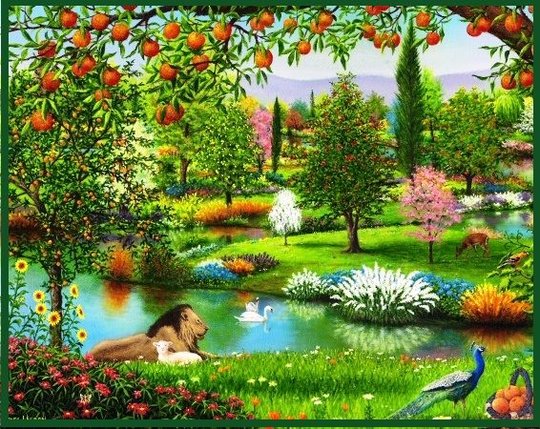
This is not the way God made the world
God created the world good, and there were no problems

Slide 4
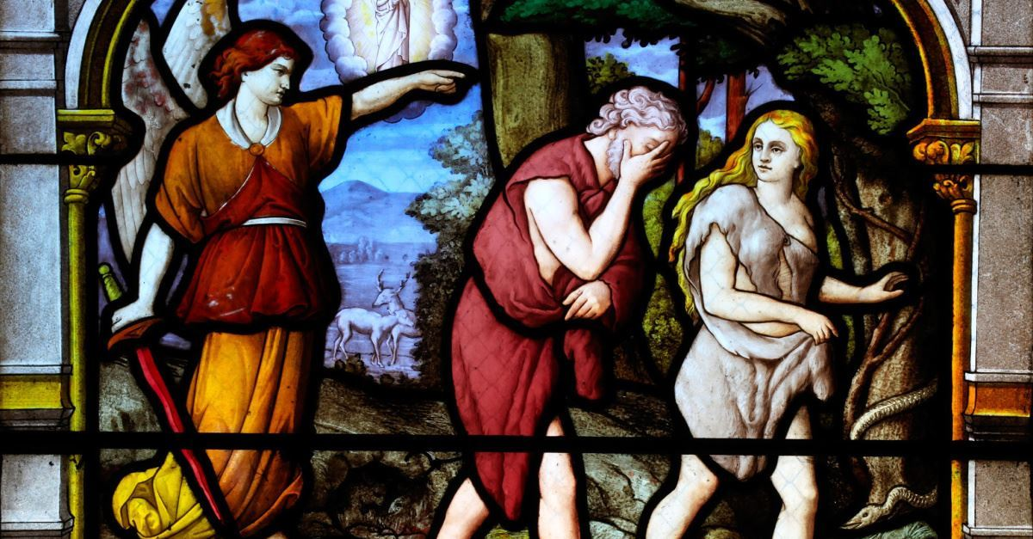
Then the first man and woman decided to disobey God

Slide 5
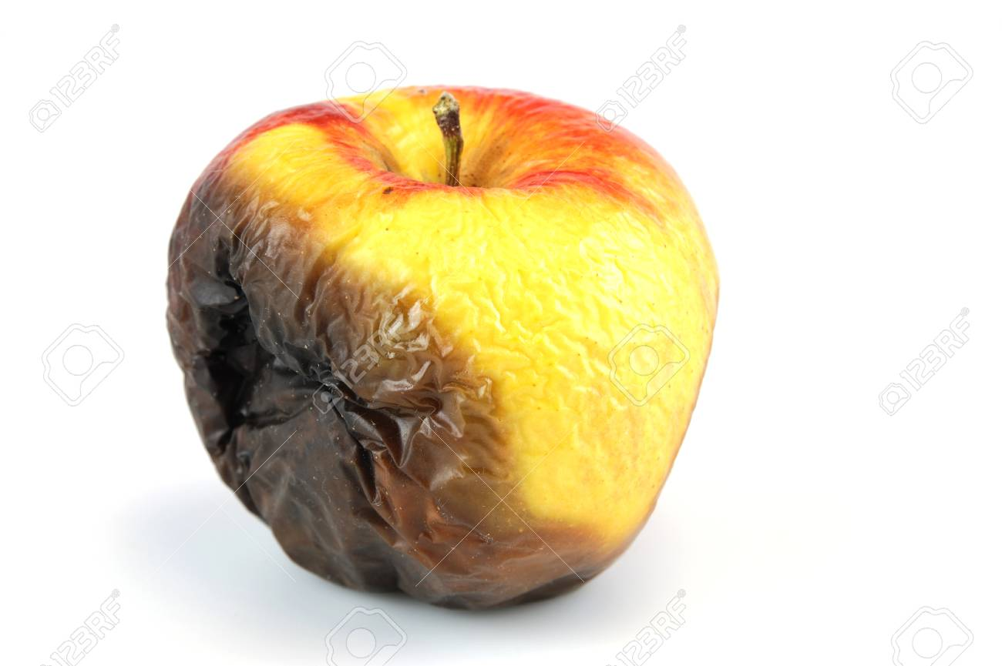
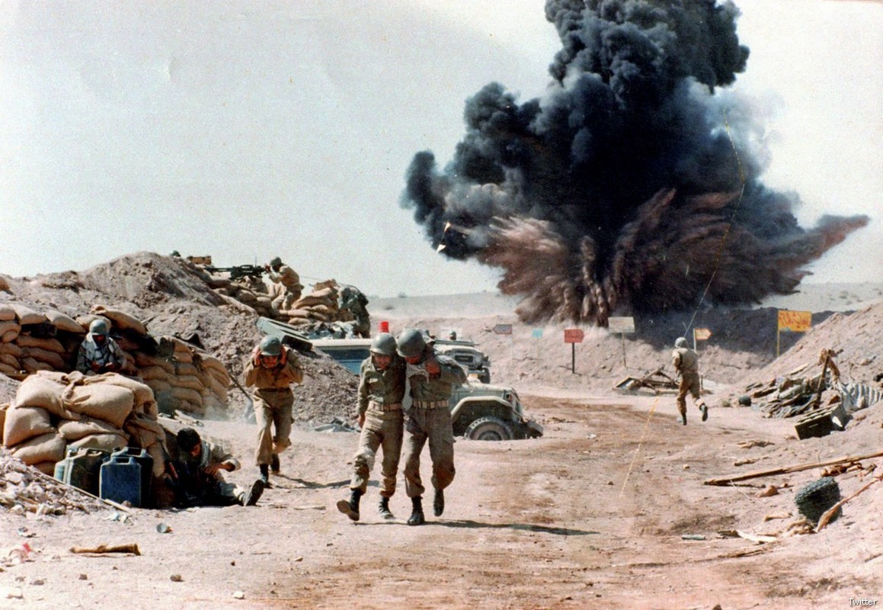
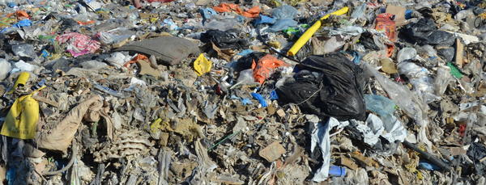
As a result, everything began to go sour

Slide 6
We have a BIG problem!
A big problem needs a big solution.
God has the solution

Slide 7
God loves you and has a wonderful plan for your life.
Love God and neighbor
High school, college,
career, service, family,
a future

Slide 8
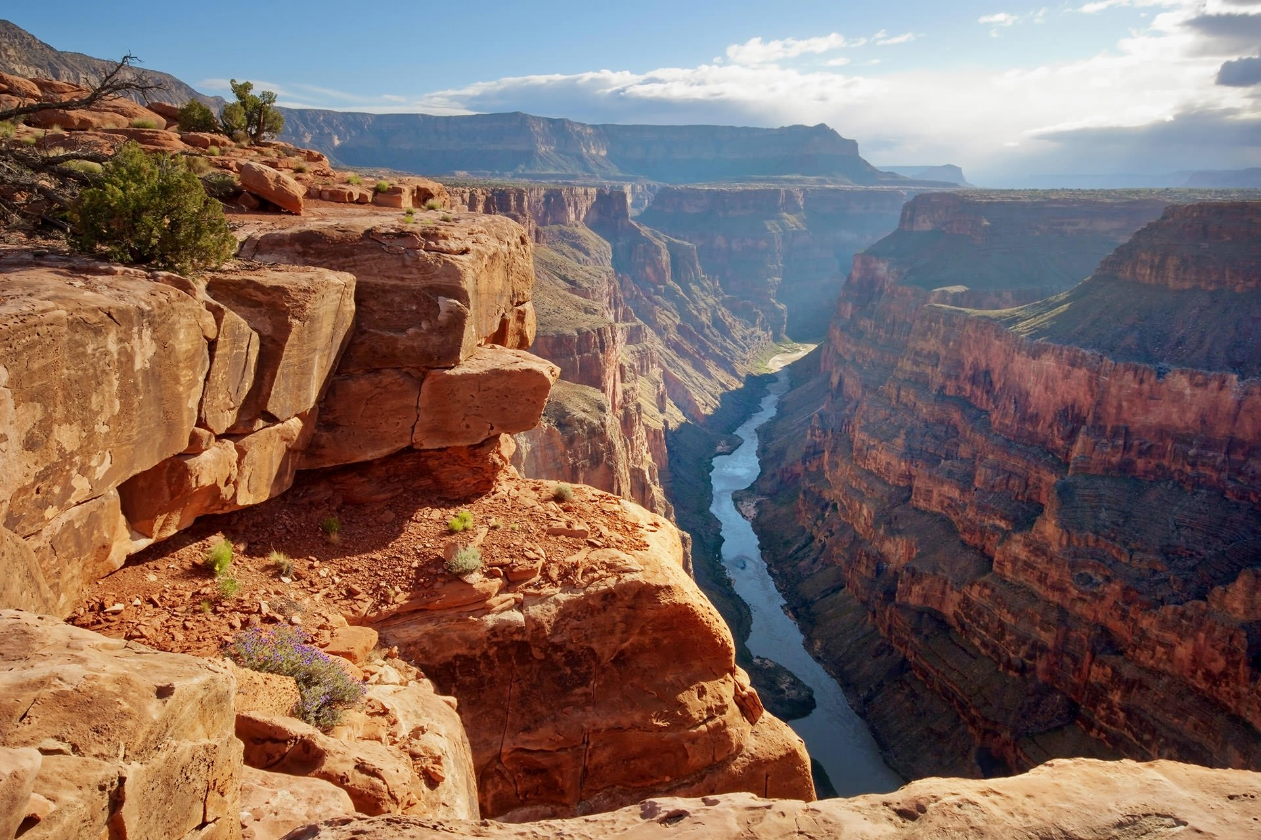
We have been separated from God and His plan through our sin

Slide 9
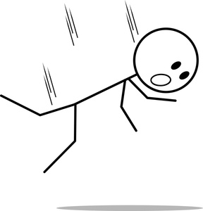
We cannot cross the gap by ourselves
Humanity on our own
Reunited with God

Slide 10
In order to cross the bridge to God,
we must accept Jesus as our Lord and Savior
As Lord: let Jesus be in charge, and do whatever he says.
As Savior: accept his gifts of forgiveness and salvation with gratitude

